Slide 1
Program security:chp2

Slide 2
Secure programs
Pgm is secure if we trust that it provides/enforces:
Confidentiality
Integrity
Availability

Slide 3
Types of flaws:
Some flaws are intentional
Malicious flaws are intentionally inserted to attack
If it's meant to attack some particular system, we call it a targeted malicious flaw
Nonmalicious (but intentional) flaws are often features that are meant to be in the system
are correctly implemented,
but can cause a failure when used by an attacker
Most security flaws are caused by unintentional program errors

Slide 4
Nonmalicious program errors
nonmalicious program errors/flaws
Buffer overflows
Incomplete mediation
TOCTTOU (time of check to time of use)errors (race conditions)‏

Slide 5
Key Concepts of Buffer Overflow
This error occurs when there is more data in a buffer than it can handle, causing data to overflow into adjacent storage.
This vulnerability can cause a system crash or, worse, create an entry point for a cyberattack.
C and C++ are more susceptible to buffer overflow.
Secure development practices should include regular testing to detect and fix buffer overflows. These practices include automatic protection at the language level and bounds-checking at run-time.

Slide 6
Definition of a Buffer Overflow
A buffer is a sequential section of memory allocated to contain anything from a character string to an array of integers. A buffer overflow, or buffer overrun, occurs when more data is put into a fixed-length buffer than the buffer can handle. The extra information, which has to go somewhere, can overflow into adjacent memory space, corrupting or overwriting the data held in that space. This overflow usually results in a system crash, but it also creates the opportunity for an attacker to run arbitrary code or manipulate the coding errors to prompt malicious actions.
Many programming languages are prone to buffer overflow attacks. However, the extent of such attacks varies depending on the language used to write the vulnerable program. For instance, code written in Perl and JavaScript is generally not susceptible to buffer overflows. However, a buffer overflow in a program written in C, C++, Fortran or Assembly could allow the attacker to fully compromise the targeted system.

Slide 7
Executing a Buffer Overflow Attack
Cybercriminals exploit buffer overflow problems to alter the execution path of the application by overwriting parts of its memory.
The malicious extra data may contain code designed to trigger specific actions — in effect sending new instructions to the attacked application that could result in unauthorized access to the system.
Hacker techniques that exploit a buffer overflow vulnerability vary per architecture and operating system.

Slide 8
Buffer Overflow Causes
Coding errors are typically the cause of buffer overflow.
Common application development mistakes that can lead to buffer overflow include failing to allocate large enough buffers and neglecting to check for overflow problems.
These mistakes are especially problematic with C/C++, which does not have built-in protection against buffer overflows. Consequently, C/C++ applications are often targets of buffer overflow attacks.

Slide 9
Buffer Overflow Attack Example
In some cases, an attacker injects malicious code into the memory that has been corrupted by the overflow.
In other cases, the attacker simply takes advantage of the overflow and its corruption of the adjacent memory.
For example, consider a program that requests a user password in order to grant the user access to the system. In the code below, the correct password grants the user root privileges. If the password is incorrect, the program will not grant the root privileges.

Slide 10
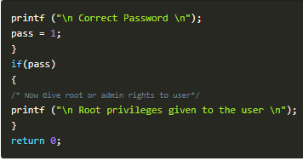

Slide 11
However, there might be a possibility of buffer overflow in a program because the gets() function does not check the array bounds.
Here is an example of what an attacker could do with this coding error:

Slide 12
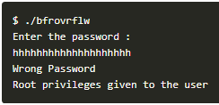

Slide 13
In the above example, the program gives the user root privileges, even though the user entered an incorrect password.
In this case, the attacker supplied an input with a length greater than the buffer can hold, creating buffer overflow, which overwrote the memory of “pass.” Therefore, despite the incorrect password, the value of “pass” became non zero, and the attacker receives root privileges.

Slide 14
Buffer Overflow Solutions
To prevent buffer overflow, developers of C/C++ applications should avoid standard library functions that are not bounds-checked, such as gets, scanf and strcpy.
In addition, secure development practices should include regular testing to detect and fix buffer overflows. The most reliable way to avoid or prevent buffer overflows is to use automatic protection at the language level.
Another fix is bounds-checking enforced at run-time, which prevents buffer overrun by automatically checking that data written to a buffer is within acceptable boundaries.

Slide 15
Incomplete mediation

Slide 16
mediation
Web-based applications are a common example
An application needs to ensure that what user has entered constitutes a meaningful request
This is called mediation

Slide 17
Incomplete mediation
Incomplete mediation occurs when the application accepts incorrect data from user

Slide 18
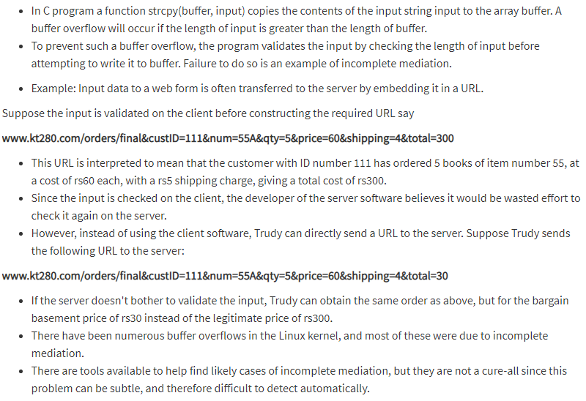

Slide 19
Defences against incomplete mediation
For values entered by the user
Always do very careful checks on the values of all fields
These values can potentially contain completely arbitrary 8-bit data and be of any length
For state stored by the client:
Make sure the client has not modified the data in any way

Slide 20
Time-Of-Check To Time-Of-Use errors
TOCTTOU (“TOCK-too”) errors
Also known as “race condition” errors
In software development, time of check to time of use (TOCTTOU or TOCTOU, pronounced "tock too") is a class of software bugs caused by changes in a system between the checking of a condition (such as a security credential) and the use of the results of that check. This is one example of a race condition.

Slide 21
This weakness can be security-relevant when an attacker can influence the state of the resource between check and use. This can happen with shared resources such as files, memory, or even variables in multithreaded programs.

Slide 22
Malicious Code
Malicious code or rogue pgm is written to exploit flaws in pgms
Malicious code can change
data
other programs
Outline for this Subsection:
General-Purpose Malicious Code (incl. Viruses)
Targeted Malicious Code

Slide 23
virus
A virus is a computer code or program, which is capable of affecting your computer data badly by corrupting or destroying them.
Computer virus has the tendency to make its duplicate copies at a swift pace, and also spread it across every folder and damage the data of your computer system.
A computer virus is actually a malicious software program or "malware" that, when infecting your system, replicates itself by modifying other computer programs and inserting its own code.

Slide 24
Following are the other malicious code…………
Worms
This is a computer program that replicates itself .Unlike a computer virus, it is self-contained and hence does not need to be part of another program to propagate itself.
Trojan Horse
A Trojan Horse is also a sort of destructive program that remains disguised in a normal software program. It is not exactly a virus, as it cannot replicate itself. However, there is possibility that virus program may remain concealed in the Trojan Horse.
Bombs
It is similar to Trojan Horse, but Logic bombs have some speciality; these include a timing device and hence it will go off only at a particular date and time.

Slide 25
How Does Virus Affect?
Let us discuss in what ways a virus can affect your computer system. The ways are mentioned below −
By downloading files from the Internet.
During the removable of media or drives.
Through pen drive.
Through e-mail attachments.
Through unpatched software & services.
Through unprotected or poor administrator passwords.

Slide 26
Impact of Virus
Let us now see the impact of virus on your computer system −
Disrupts the normal functionality of respective computer system.
Disrupts system network use.
Modifies configuration setting of the system.
Destructs data.
Disrupts computer network resources.
Destructs of confidential data.

Slide 27
Virus Detection
The most fundamental method of detection of virus is to check the functionality of your computer system; a virus affected computer does not take command properly.
However, if there is antivirus software in your computer system, then it can easily check programs and files on a system for virus signatures.

Slide 28
Virus Preventive Measures
A computer system can be protected from virus through the following −
Installation of an effective antivirus software.
Patching up the operating system.
Patching up the client software.
Putting highly secured Passwords.
Use of Firewalls.

Slide 29
Most Effective Antivirus
Following are the most popular and effective antivirus from which you can choose one for your personal computer −
McAfee Antivirus Plus
Symantec Norton Antivirus
Avast Pro Antivirus
Bitdefender Antivirus Plus
Kaspersky Anti-Virus
Avira Antivirus
Webroot Secure Anywhere Antivirus
Emsisoft Anti-Malware
Quick Heal Antivirus
ESET NOD32 Antivirus

Slide 30
Malicious software
Malicious software (malware) is any software that gives partial to full control of the system to the attacker/malware creator.

Slide 31
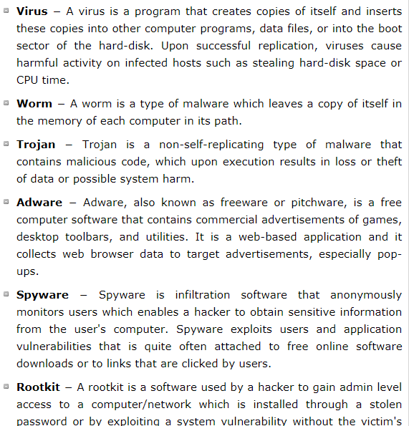

Slide 32
Targeted Malicious Code
Targeted = written to attack a particular system, a particular application, and for a particular purpose

Slide 33
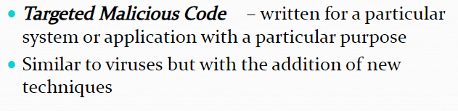

Slide 34
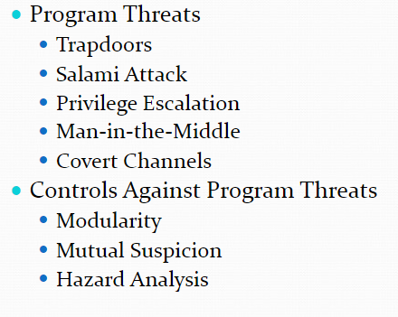

Slide 35
Trapdoors
A trapdoor is an undocumented entry point to a module. The trapdoor is inserted during code development, perhaps to test the module, to provide "hooks" by which to connect future modifications or enhancements or to allow access if the module should fail in the future.
In addition to these legitimate uses, trapdoors can allow a programmer access to a program once it is placed in production.

Slide 36
Testing:
each small component of the system is tested first, separate from the other components, in a step called unit testing, to ensure that the component works correctly by itself. Then, components are tested together during integration testing, to see how they function as they send messages and data from one to the other.

Slide 37

Source of trapdoors

Slide 38
Stubs and Drivers are two types of test harness. Test harness are the collection of software and test data which is configured so that we can test a program unit by simulating different set of conditions, while monitoring the behavior and outputs.
Stubs and drivers both are dummy modules and are only created for test purposes.

Slide 39
Stubs are used in top down testing approach, when you have the major module ready to test, but the sub modules are still not ready yet. So in a simple language stubs are "called" programs, which are called in to test the major module's functionality.

Slide 40
For eg. suppose you have three different modules : Login, Home, User. Suppose login module is ready for test, but the two minor modules Home and User, which are called by Login module are not ready yet for testing. At this time, we write a piece of dummy code, which simulates the called methods of Home and User. These dummy pieces of code are the stubs. On the other hand, Drivers are the ones, which are the "calling" programs. Drivers are used in bottom up testing approach. Drivers are dummy code, which is used when the sub modules are ready but the main module is still not ready. Taking the same example as above. Suppose this time, the User and Home modules are ready, but the Login module is not ready to test. Now since Home and User return values from Login module, so we write a dummy piece of code, which simulates the Login module. This dummy code is then called Driver.

Slide 41
Source of trapdoor (cont)
Poor error checking is another source of trapdoors. A good developer will design a system so that any data value is checked before it is used; the checking involves making sure the data type is correct as well as ensuring that the value is within acceptable bounds. But in some poorly designed systems, unacceptable input may not be caught and can be passed on for use in unanticipated ways.

Slide 42
Causes of Trapdoors
trapdoors can persist in production programs because the developers:
forget to remove them
intentionally leave them in the program for testing
intentionally leave them in the program for maintenance of the finished program, or
intentionally leave them in the program as a covert means of access to the component after it becomes an accepted part of a production system

Slide 43
It is important to remember that the fault is not with the trapdoor itself, which can be a very useful technique for program testing, correction, and maintenance. Rather, the fault is with the system development process, which does not ensure that the trapdoor is "closed" when it is no longer needed. That is, the trapdoor becomes a vulnerability if no one notices it or acts to prevent or control its use in vulnerable situations.
In general, trapdoors are a vulnerability when they expose the system to modification during execution. They can be exploited by the original developers or used by anyone who discovers the trapdoor by accident or through exhaustive trials. A system is not secure when someone believes that no one else would find the hole.

Slide 44
In short

Slide 45
Trapdoors (1)
Original def:
Trapdoor / backdoor - A hidden computer flaw known to an intruder, or a hidden computer mechanism (usually software) installed by an intruder, who can activate the trap door to gain access to the computer without being blocked by security services or mechanisms.
A broader definition:
Trapdoor – an undocumented entry point to a module
Inserted during code development
For testing
As a hook for future extensions
As emergency access in case of s/w failure

Slide 46
Trapdoors (2)
Testing:
With stubs and drivers for unit testing
Testing with debugging code inserted into tested modules
May allow programmer to modify internal module variables
Major sources of trapdoors:
Left-over (purposely or not) stubs, drivers, debugging code
Poor error checking
E.g., allowing for unacceptable input that causes buffer overflow
Undefined opcodes in h/w processors
Some were used for testing, some random
Not all trapdoors are bad
Some left purposely w/ good intentions
— facilitate system maintenance/audit/testing

Slide 47
Salami attack
What is a Salami Attack?
A salami attack is when small attacks add up to one major attack that can go undetected due to the nature of this type of cyber crime. It also known as salami slicing.
Although salami slicing is often used to carry out illegal activities, it is only a strategy for gaining an advantage over time by accumulating it in small increments, so it can be used in perfectly legal ways as well .
The attacker uses an online database to seize the information of customers that is bank/credit card details deducting very little amounts from every account over a period of time. The customers remain unaware of the slicing and hence no complaint is launched thus keeping the hacker away from detection.
Eg: interest computation

Slide 48
privilege escalation
A privilege escalation attack is a type of network intrusion that takes advantage of programming errors or design flaws to grant the attacker elevated access to the network and its associated data and applications.

Slide 49
Not every system hack will initially provide an unauthorized user with full access to the targeted system. In those circumstances privilege escalation is required. There are two kinds of privilege escalation: vertical and horizontal.
Vertical privilege escalation requires the attacker to grant himself higher privileges. This is typically achieved by performing kernel-level operations that allow the attacker to run unauthorized code.
Horizontal privilege escalation requires the attacker to use the same level of privileges he already has been granted, but assume the identity of another user with similar privileges. For example, someone gaining access to another person's online banking account would constitute horizontal privilege escalation.

Slide 50
Man in the middle

Slide 51
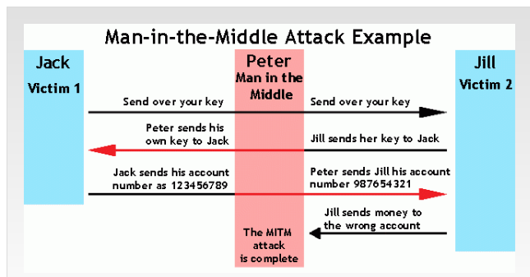

Slide 52
Other Forms of Session Hijacking
Man-in-the-middle is a form of session hijacking. Other forms of session hijacking similar to man-in-the-middle are:
Sidejacking - This attack involves sniffing data packets to steal session cookies and hijack a user’s session. These cookies can contain unencrypted login information, even if the site was secure.
Evil Twin - This is a rogue Wi-Fi network that appears to be a legitimate network. When users unknowingly join the rogue network, the attacker can launch a man-in-the-middle attack, intercepting all data between you and the network.
Sniffing - This involves a malicious actor using readily available software to intercept data being sent from, or to, your device.

Slide 53
Covert channels
any communication channel that can be exploited by a process to transfer information in a manner that violates the system's security policy.

Slide 54
covert channel is a type of attack that creates a capability to transfer information objects between processes that are not supposed to be allowed to communicate by the computer security policy.

Slide 55
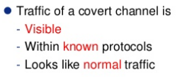

Slide 56
A covert channel is created by a sender process that modulates some condition (such as free space, availability of some service, wait time to execute) that can be detected by a receiving process.
two kinds of covert channels:
Storage channels - Communicate by modifying a "storage location", such as a hard drive.
Timing channels - Perform operations that affect the "real response time observed" by the receiver.

Slide 57
example
Data hiding in TCP/IP Protocol suite by covert channels
Data hiding in LAN environment by covert channels

Slide 58
CONTROLS AGAINST PROGRAM THREATS
Prevention from threats
In this section we look at three types of controls: developmental, operating system, and administrative.

Slide 59
Developmental control
Many controls can be applied during software development to figure out and fix problems. So let us begin by looking at the nature of development itself, to see what tasks are involved in specifying, designing, building, and testing software.

Slide 60
The Nature of Software Development
Software development is often considered a solitary effort; a programmer sits with a specification or design and grinds out line after line of code. But in fact, software development is a collaborative effort, involving people with different skill sets who combine their expertise to produce a working product.

Slide 61
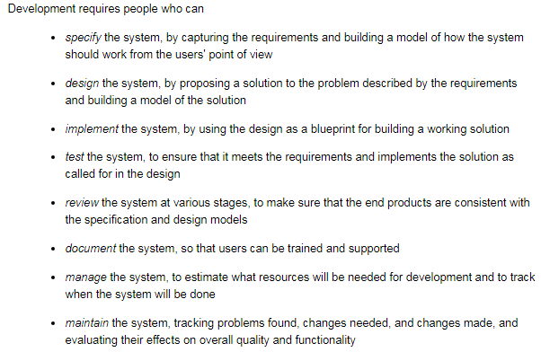

Slide 62
One person could do all these things. But more often than not, a team of developers works together to perform these tasks. Sometimes a team member does more than one activity; a tester can take part in a requirements review, for example, or an implementer can write documentation. Each team is different, and team dynamics play a large role in the team's success.

Slide 63
Modularity, Encapsulation, and Information Hiding
a key principle of software engineering is to create a design or code in small, self-containedunits, called components or modules; when a system is written this way, we say that it is modular. Modularity offers advantages for program development in general and security in particular.

Slide 64
If a component is isolated from the effects of other components, then it is easier to trace a problem to the fault that caused it and to limit the damage the fault causes. It is also easier to maintain the system, since changes to an isolated component do not affect other components. And it is easier to see where vulnerabilities may lie if the component is isolated. We call this isolation encapsulation.

Slide 65
Information hiding is another characteristic of modular software. When information is hidden, each component hides its precise implementation or some other design decision from the others. Thus, when a change is needed, the overall design can remain intact while only the necessary changes are made to particular components.

Slide 66
There are several advantages to having small, independent components.

Slide 67
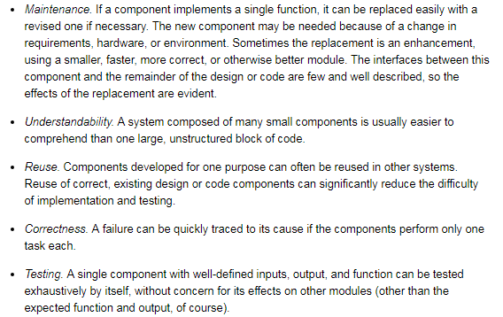

Slide 68
Coupling and cohesion
A modular component usually has high cohesion and low coupling. By cohesion, we mean that all the elements of a component have a logical and functional reason for being there; every aspect of the component is tied to the component's single purpose. A highly cohesive component has a high degree of focus on the purpose; a low degree of cohesion means that the component's contents are an unrelated jumble of actions, often put together because of time-dependencies or convenience.
Coupling refers to the degree with which a component depends on other components in the system. Thus, low or loose coupling is better than high or tight coupling, because the loosely coupled components are free from unwitting interference from other components

Slide 69
Peer Reviews
We turn next to the process of developing software. Certain practices and techniques can assist us in finding real and potential security flaws (as well as other faults) and fixing them before the system is turned over to the users. Of the many practices available for building what they call "solid software," Pfleeger et al. recommend several key techniques: [PFL01a]
peer reviews
hazard analysis
testing
good design
prediction
static analysis
configuration management
analysis of mistakes
Here, we look at each practice briefly, and we describe its relevance to security controls. We begin with peer reviews.

Slide 70
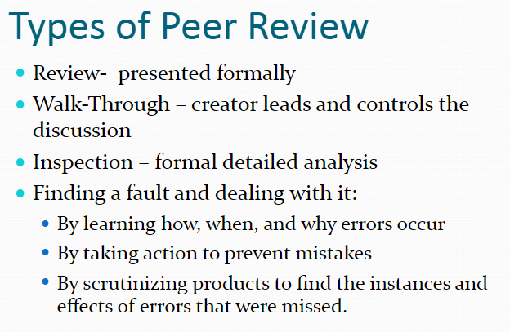

Slide 71
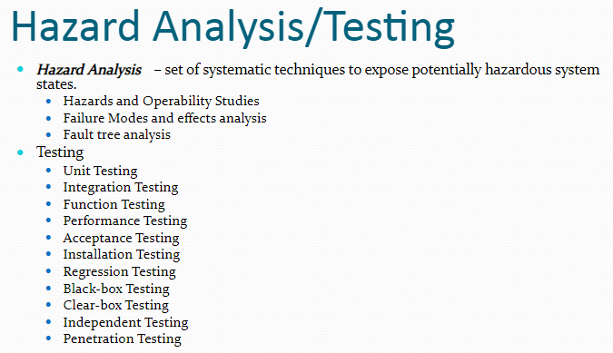

Slide 72
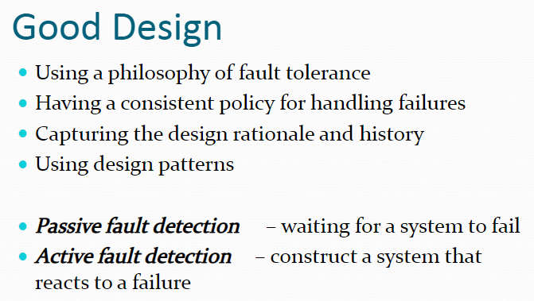

Slide 73
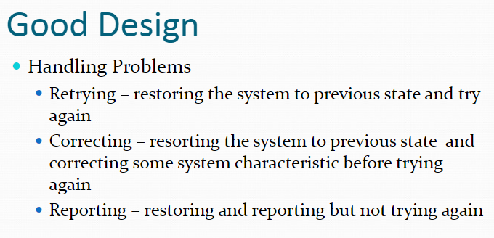

Slide 74
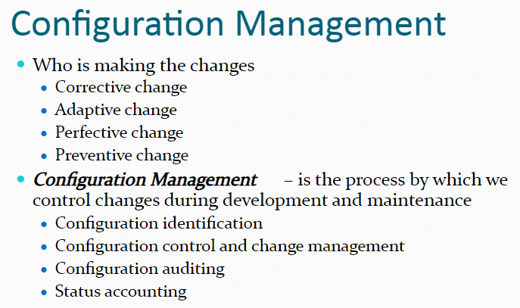

Slide 75
c. Operating System Controls for Security (1)
Developmental controls not always used
OR:
Even if used, not foolproof
=> Need other, complementary controls, incl. OS controls
Such OS controls can protect against some pgm flaws

Slide 76
Operating System Controls on Use of Programs
Trusted Software
code has been rigorously developed and analyzed
Functional correctness
Enforcement of integrity
Limited privilege
Appropriate confidence level
CS 450/650 Lecture 16: Targeted Malicious Codes
76

Slide 77
Operating System Controls for Security (3)
Key characteristics determining if OS code is trusted
1) Functional correctness
OS code should be consistent
2) Enforcement of integrity
OS keeps integrity of its data and other resources even if presented with flawed or unauthorized commands
3) Limited privileges
OS minimizes access to secure data/resources
Trusted pgms must have „need to access” and proper access rights to use resources protected by OS
Untrusted pgms can’t access resources protected by OS
4) Appropriate confidence level
OS code examined and rated at appropriate trust level

Slide 78
Similar criteria used to establish if s/w other than OS can be trusted
To increasing security if untrusted pgms present:
Mutual suspicion
Confinement
Access log

Slide 79
Operating System Controls on Use of Programs
Mutual Suspicion
assume other program is not trustworthy
Confinement
limit resources that program can access
Access Log
list who access computer objects, when, and for how long
CS 450/650 Lecture 16: Targeted Malicious Codes
79

Slide 80
Administrative Controls
Standards of Program Development
Standards of design
Standards of documentation, language, and coding style
Standards of programming
Standards of testing
Standards of configuration management
Security Audits
Separation of Duties
CS 450/650 Lecture 16: Targeted Malicious Codes
80

Slide 81
Administrative Controls for Security (2)
1) Standards and guidelines for program development
Capture experience and wisdom from previous projects
Facilitate building higher-quality s/w (incl. more secure)
They include:
Design S&G – design tools, languages, methodologies
S&G for documentation, language, and coding style
Programming S&G - incl. reviews, audits
Testing S&G
Configuration mgmt S&G
2) Security audits
Check compliance with S&G
Scare potential dishonest programmer from including illegitimate code (e.g., a trapdoor)

Slide 82
Administrative Controls for Security (3)
3) Separation of duties
Break sensitive tasks into ≥ 2 pieces to be performed by different people (learned from banks)
Example 1: modularity
Different developers for cooperating modules
Example 2: independent testers
Rather than developer testing her own code

Slide 83
e. Conclusions (for Controls for Security)
Developmental / OS / administrative controls help produce/maintain higher-quality (also more secure) s/w
„A good developer who truly understands security will incorporate security into all phases of development.”
Summary:
Control | Purpose | Benefit
Develop- mental | Limit mistakes Make malicious code difficult | Produce better software
OperatingSystem | Limit access to system | Promotes safe sharing of info
Adminis-trative | Limit actions of people | Improve usability, reusability and maintainability

Slide 84
Threat analysis
Defn of threat:
“Any circumstance or event with the potential to adversely impact an IS through unauthorized access, destruction, disclosure, modification of data, and/or denial of service.”

Slide 85
Types of Threat
Following are the most common types of computer threats −
Physical damage − It includes fire, water, pollution, etc.
Natural events − It includes climatic, earthquake, volcanic activity, etc.
Loss of services − It includes electrical power, air conditioning, telecommunication, etc.
Technical failures − It includes problems in equipment, software, capacity saturation, etc.
Deliberate type − It includes spying, illegal processing of data, etc.
Some other threats include error in use, abuse of rights, denial of actions, eavesdropping, theft of media, retrieval of discarded materials, etc.

Slide 86
Sources of Threat
The possible sources of a computer threat may be −
Internal − It includes employees, partners, contractors (and vendors).
External − It includes cyber-criminals (professional hackers), spies, non-professional hackers, activists, malware (virus/worm/etc.), etc.

Slide 87
Common Terms
Following are the common terms frequently used to define computer threat −
Virus Threats
A computer virus is a program designed to disrupt the normal functioning of the computer without the permission of the user.
Spyware Threats
Spyware is a computer program that monitors user’s online activities or installs programs without user’s consent for profit or theft of personal information.
Hackers
Hackers are programmers who put others on threats for their personal gain by breaking into computer systems with the purpose to steal, change or destroy information.

Slide 88
Phishing Threats
It is an illegal activity through which phishers attempt to steal sensitive financial or personal data by means of fraudulent email or instant messages.

Slide 89
How to Secure Your Computer System from Threats?
Following are the significant tips through which you can protect your system from different types of threat −
Install, use, and keep updated Anti-Virus in your system.
Install, use, and keep updated a Firewall Program.
Always take backups of your important Files and Folders.
Use Strong and Typical Passwords.
Take precaution especially when Downloading and Installing Programs.
Install, use, and keep updated a File Encryption Program.
Take precaution especially when Reading Email with Attachments.
Keep your Children aware of Internet threats and safe browsing.

Slide 90
Threat Analysis
Threats are agents that violate the protection of information assets and site security policy. Threat analysis identifies for a specific architecture, functionality and configuration. Threat analysis may assume a given level of access and skill level that the attacker may possess. Threats may be mapped to vulnerabilities to understand how the system may be exploited. A mitigation plan is composed of countermeasures that are considered to be effective against the identified vulnerabilities that the threats exploit.
Attackers who are not technologically sophisticated are increasingly performing attacks on systems without really understanding what it is they are exploiting, because the weakness was discovered by someone else. These individuals are not looking to target specific information or a specific company but rather use knowledge of a vulnerability to scan the entire InternetAttackers who are not technologically sophisticated are increasingly performing attacks on systems without really understanding what it is they are exploiting, because the weakness was discovered by someone else. These individuals are not looking to target specific information or a specific company but rather use knowledge of a vulnerability to scan the entire Internet for systems that possess that vulnerability. The table below, which was developed by NIST [4, p. 14], summarizes potential threat sources:

Slide 91
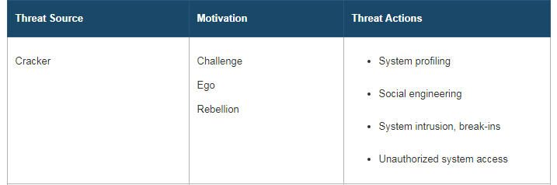

Slide 92
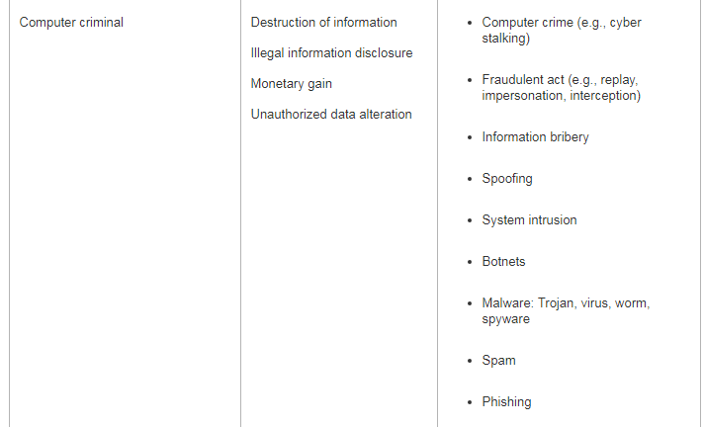

Slide 93
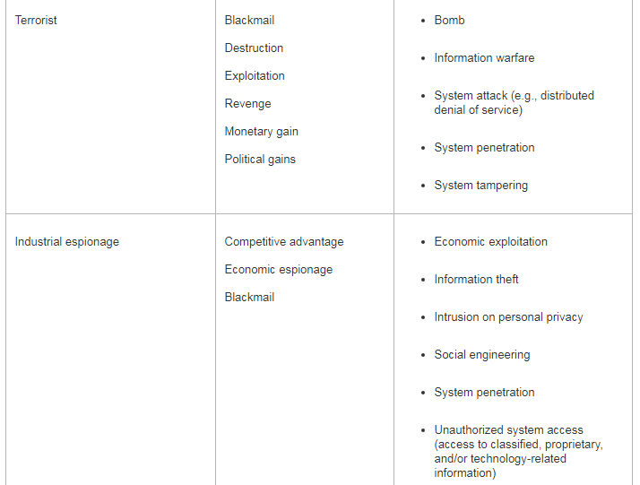

Slide 94
